Slide 1
visualization
Soumya banerjee

Slide 2
Basics and pitfalls in data visualization (TUFTE) 1. Less is more. “Above all else show the data” (p. 92). 2. “Graphical excellence consists of complex ideas communicated with clarity, precision, and efficiency.” (p. 51) 3. Keep it proportional! “Lie Factor = size of effect shown in graphic divided by size of effect in data” (p.57). Keep it close to 1. 4.You don’t have to use a graphic when there isn’t much data — a table is often better. 5. Pie charts are useless.
Principles of data visualization (Edward tufte)
https://jeffhale.medium.com/five-takeaways-from-the-visual-display-of-quantitative-information-dd36dae35299
Notes:
Example of IL10 project (tSNE and heatmaps from a bioinformatics project)

Slide 3

Basics and pitfalls in data visualization 1. Tufte 2. Less is more. “Above all else show the data” (p. 92). Erase everything you don’t need. “Graphical excellence consists of complex ideas communicated with clarity, precision, and efficiency.” (p. 51) Keep it proportional! “Lie Factor = size of effect shown in graphic divided by size of effect in data” (p.57). Keep it close to 1. You don’t have to use a graphic when there isn’t much data — a table is often better. Pie charts are useless. The dude hates pie charts.
Principles of data visualization (tufte)
Notes:
Example of IL10 project (tSNE and heatmaps from a bioinformatics project)

Slide 4

The best statistical graphic ever drawn
Notes:
Multiple dimensions on one plot
Code and data available see PDF

Slide 5
1. https://pudding.cool/projects/heat-records-map/ 2. https://pudding.cool/2022/12/yard-sale/ power law distributions
Principles of data visualization (tufte)
Notes:
Example of IL10 project (tSNE and heatmaps from a bioinformatics project)

Slide 6
Heatmaps tSNE communicate data storytelling distances not preserved stochastic difficult to communicate to non-technical experts
Principles of data visualization
Notes:
Example of IL10 project (tSNE and heatmaps from a bioinformatics project)

Slide 7
problems with communicating high dimensional data. High dimensions are difficult to visualize maps 3d to 2d
Visualizing high-dimensions
Notes:
Example of IL10 project (tSNE and heatmaps from a bioinformatics project)

Slide 8

Important concept
Information bottleneck

Slide 9
assumptions
Linearity (linear relationship between data points and lower dimensional representation)
Loss function/reconstruction error (squared loss)
Uses the dot product (one type of inner product)

Slide 10
generalizations of this idea
tSNE
Autoencoder (non-linear loss function)

Slide 11
pitfalls
Distances not preserved
tSNE can be used for hypothesis generation. There are many pitfalls to this.
https://distill.pub/2016/misread-tsne/
Other pitfalls: distances not preserved. For example, a 2d map is a projection from 3D

Slide 12
Case studies
removing outliers in genomic data using PCA.
Frequently in genomic data we may have to remove outliers. These outliers may be due to technical/batch effects or unknown reasons not connected to biology.
This has implications for any tests performed downstream. For example, t-tests can be performed downstream after performing PCA. If there are outliers, it may affect the results of the t-test. See \cite{Aschenbrenner2019} for an application to bulk and single-cell sequencing data.

Slide 13
Case studies
Visualization/dimensionality reduction pitfalls
Pitfalls
https://distill.pub/2016/misread-tsne/
Other pitfalls: distances not preserved. For example, a 2d map is a projection from 3D

Slide 14

Case study
Color scales
Notes:
Example of IL10 project (tSNE and heatmaps from a bioinformatics project)

Slide 15
Visualizations can be misleading
1. distances not preserved in tsne
https://distill.pub/2016/misread-tsne/
2. cluster sizes do not matter 3. you can see some shapes sometimes
4. random does not always look random
Notes:
Example of IL10 project (tSNE and heatmaps from a bioinformatics project)

Slide 16

Visualizations can be misleading
But what if the two clusters have different standard deviations, and so different sizes? (By size we mean bounding box measurements, not number of points.) Below are t-SNE plots for a mixture of Gaussians in plane, where one is 10 times as dispersed as the other.
But what if the two clusters have different standard deviations, and so different sizes? (By size we mean bounding box measurements, not number of points.) Below are t-SNE plots for a mixture of Gaussians in plane, where one is 10 times as dispersed as the other.
Surprisingly, the two clusters look about same size in the t-SNE plots. What’s going on? The t-SNE algorithm adapts its notion of “distance” to regional density variations in the data set. As a result, it naturally expands dense clusters, and contracts sparse ones, evening out cluster sizes.
Notes:
Example of IL10 project (tSNE and heatmaps from a bioinformatics project)

Slide 17

Visualizations can be misleading
diagrams show three Gaussians of 50 points each, one pair being 5 times as far apart as another pair.
At perplexity 50, the diagram gives a good sense of the global geometry. For lower perplexity values the clusters look equidistant. When the perplexity is 100, we see the global geometry fine, but one of the cluster appears, falsely, much smaller than the others. Since perplexity 50 gave us a good picture in this example, can we always set perplexity to 50 if we want to see global geometry?
The basic message is that distances between well-separated clusters in a t-SNE plot may mean nothing.
Notes:
Example of IL10 project (tSNE and heatmaps from a bioinformatics project)

Slide 18

Visualizations can be misleading
Notes:
Example of IL10 project (tSNE and heatmaps from a bioinformatics project)

Slide 19
Visualizations can be misleading
Hence communicate clearly with stakeholders and validate these findings
See the tSNE plots again. What pitfalls do you see in communicating these insights to experimentalists?
Notes:
Example of IL10 project (tSNE and heatmaps from a bioinformatics project)

Slide 20

Case study
Notes:
Example of IL10 project (tSNE and heatmaps from a bioinformatics project)

Slide 21

Case study
Notes:
Example of IL10 project (tSNE and heatmaps from a bioinformatics project)

Slide 22

Case study
Notes:
Can anyone guess why this map is distorted?

Slide 23

Notes:
Example of IL10 project (tSNE and heatmaps from a bioinformatics project)

Slide 24
T-test
Removing outliers and then some downstream processing
Notes:
Example of IL10 project (tSNE and heatmaps from a bioinformatics project)

Slide 25
Design matrix Glm Correlated periodic Exponential Hiow to pick How do I get to this out of data How do I communicate this to stakeholders More tools for data visualization Generate data Visualize it High dumenosional data Results visualizE Communicate this Cancer woring link winter environmental actiivis Rachel carson silent spring pitfalls prob visualize
Notes:
Example of IL10 project (tSNE and heatmaps from a bioinformatics project)

Slide 26
Basics and pitfalls in data visualization 1. Know your audience 2. Pick visualization based on audience 3. Visualize data and then pick models 4. Add narrative
Notes:
Example of IL10 project (tSNE and heatmaps from a bioinformatics project)

Slide 27

Notes:
Example of IL10 project (tSNE and heatmaps from a bioinformatics project)

Slide 28

Notes:
Example of IL10 project (tSNE and heatmaps from a bioinformatics project)

Slide 29

Notes:
Example of IL10 project (tSNE and heatmaps from a bioinformatics project)

Slide 30

Assumptions: linearity

Slide 31

Assumptions: linearity

Slide 32


Assumptions: linearity
Other predictors
Transformation of response
Transformation of features

Slide 33

Assumptions
Homoskedasticity
the variability of your data should be approximately equal across the range of your predicted values

Slide 34

Assumptions
Homoskedasticity
WHAT TO DO? TRANSFORM YOUR DATA

Slide 35

Assumptions
NORMALITY OF RESIDUALS
Q-Q plot
https://stackoverflow.com/questions/13865596/quantile-quantile-plot-using-scipy

Slide 36

Data transformations
Log-log plots
Check these for normality. For example, if the distribution is not normal, then maybe you can transform the data somehow.
https://statisticsbyjim.com/regression/log-log-plots/
Notes:
https://statisticsbyjim.com/regression/log-log-plots/

Slide 37

Absence of influential data points
Run the analysis with and without influential data points
Notes:
https://statisticsbyjim.com/regression/log-log-plots/

Slide 38

independence
Study design
Mixed effects models
Notes:
https://statisticsbyjim.com/regression/log-log-plots/

Slide 39
resource
Code for visualization in R, model diagnostics and linear mixed effects models
https://github.com/neelsoumya/anova_linear_mixed_effects_examples
Notes:
https://statisticsbyjim.com/regression/log-log-plots/

Slide 40

Time series data and autocorrelations
Seasonality
autocorrelations
Notes:
https://statisticsbyjim.com/regression/log-log-plots/

Slide 41
Time series data
Visualizing the data (for example, time-series data) can reveal what kinds of models would be appropriate. For example, if time series data has some seasonality, then a seasonal auto-regressive model (SARIMA) may be appropriate.
Visualization may also reveal if the underlying model/assumptions may have changed after a certain time. For example, in financial time-series data, there usually is a change after 2008 due to the global financial crisis.
This may suggest that a new model or more data is required.
Notes:
Example of IL10 project (tSNE and heatmaps from a bioinformatics project)

Slide 42

Time series data
Notes:
Example of IL10 project (tSNE and heatmaps from a bioinformatics project)

Slide 43
Time series data
Assumptions
Similar to linear regression/GLM (VAR model/ARIMA)
Look at correlations
Simpler models are better (moving averages better than anything fancy/ML)
Notes:
Example of IL10 project (tSNE and heatmaps from a bioinformatics project)

Slide 44

Time series data
1. Area and volumes
2. Design effect vs. data effect
Notes:
Area volume design effect cs data effect

Slide 45

Time series data
1. Area and volumes
2. Design effect vs. data effect
Notes:
In the fuel economy example, the Data Increase is 53%, but the Graphical Increase is 783%, resulting in a Lie Factor of 14.8!

Slide 46

Time series data
1. Area and volumes
2. Design effect vs. data effect
3. The number of information carrying dimensions depicted should not exceed the number of dimensions of the data
Notes:
Area volume design effect cs data effect

Slide 47

Notes:
Example of IL10 project (tSNE and heatmaps from a bioinformatics project)

Slide 48
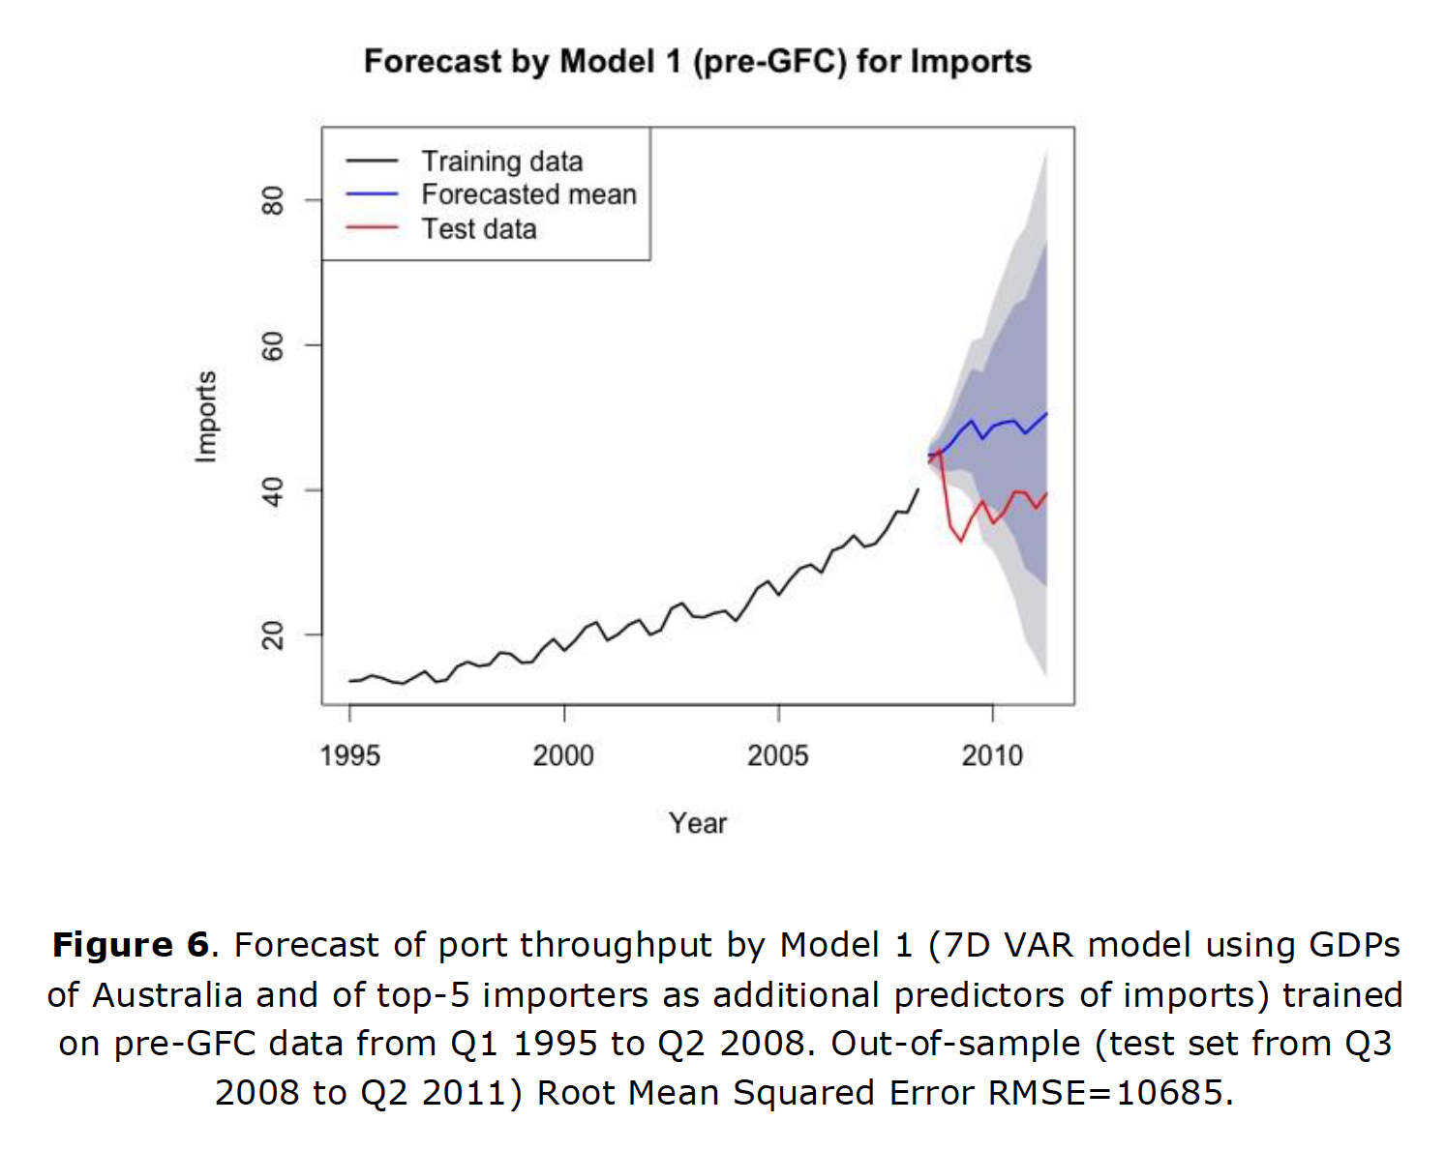
Notes:
Example of IL10 project (tSNE and heatmaps from a bioinformatics project)

Slide 49

Notes:
Example of IL10 project (tSNE and heatmaps from a bioinformatics project)

Slide 50
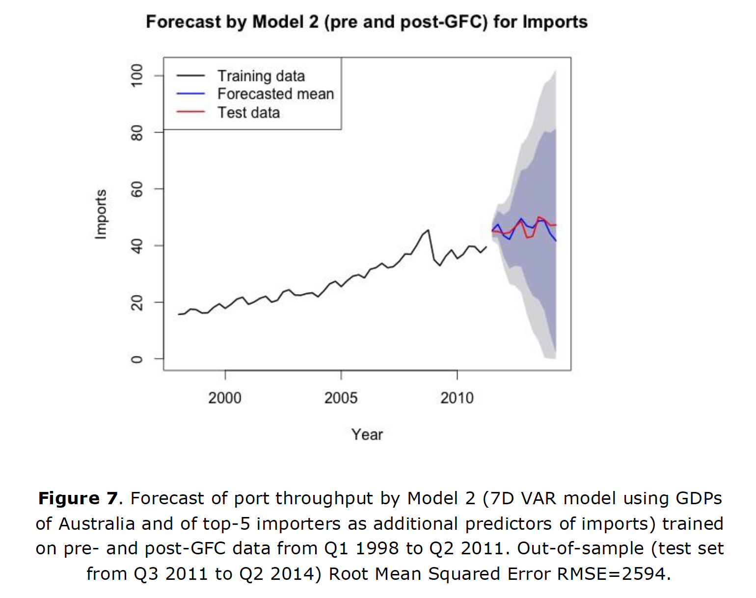
Notes:
Example of IL10 project (tSNE and heatmaps from a bioinformatics project)

Slide 51
Shiny apps for rapid prototyping and communication
shiny apps for visualization and communication
xx
Reproducible analysis
xx
Notes:
Example of IL10 project (tSNE and heatmaps from a bioinformatics project)

Slide 52
Why and when of visualization
Visualization for diagnostics, picking models
Visualization for data storytelling and for communication
Visualization not just at the end of the data science pipeline but throughout
Notes:
Example of IL10 project (tSNE and heatmaps from a bioinformatics project)

Slide 53
material
Material, code, exercises, activities
https://github.com/neelsoumya/visualization_lecture
Derivations and technical details
https://github.com/neelsoumya/visualization_lecture/blob/main/mathematics_data_science.pdf

